Slide 1
Next Gen EDSFF All Flash Storage Platform and CXL Solutions
July 2023
Patrick Chiu, Sr Dir of Product Management
Calbert Lo, Manager of Product Management

Slide 2
Agenda
EDSFF storage product evolution
Next Generation EDSFF platform Innovation
E3.S 2T CXL system management challenges

Slide 3
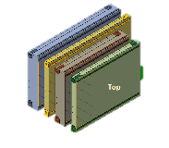
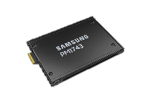
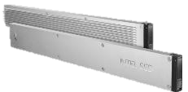
Benefits of EDSFF SSDs
For Both System Architects/Designers and Data Center End-Users
Capacity Scaling
Wider PCBs for more flexible NAND Chip layouts
EDSFF E1.S
EDSFF E3
Performance Scaling
Scalable Connector Design, Multiple Link widths (x4, x8, x16) and support different power profiles
Thermal Efficient
Improvements for thermal and cooling management
Future Proofed
Common connector for all form factors and more robust signal integrity for future PCIe generations
Solution Range
Wild range of power profiles (20W - 70W) for higher capacity/performance SSDs, SCM and networking
EDSFF E1.L

Slide 4
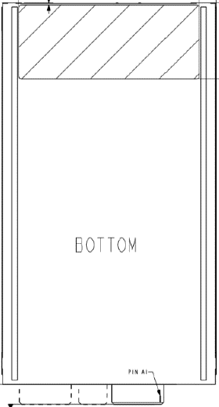
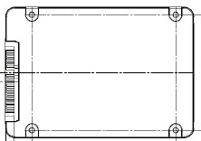
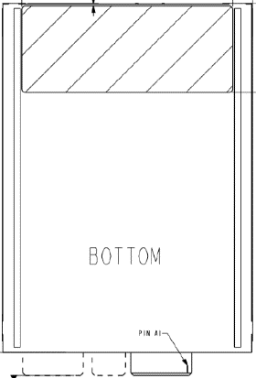
NVMe SSD Form Factor Comparison
E3.S
E3.L
E3.S/2T
Thickness: 7.5mm/16.8mm
Max Power: 25W/40W
U.2
Thickness: 7.0mm/15.0mm
Max Power: 25W
69.85mm
x4 / x8 / x16
76.0mm
x4 only
E3.L/2T
Thickness: 7.5mm / 16.8mm
Max Power: 40W/ 70W
100.45mm
112.75mm
M.2
Thickness: 4.3mm MAX
Max Power: 8W
42
60
80
142.2mm
110
x4 only
22.0mm
110.0mm
E1.S
Thickness: 5.9mm / 8.01mm
Max Power: 12W/16W
x4 / x8
E1.S
Thickness: 9.5mm/15.0mm/25.0mm
Max Power: 20W/20W/25W
31.5mm
x4 / x8
33.75mm
110.49mm
118.75mm
E1.L
Thickness: 9.5mm/18.0mm
Max Power: 25W/ 40W
x4 / x8
38.4mm
318.75mm
*Reference: 3.5” HDD Dimension: 147mm x 101.6mm, thickness: 25.4mm/26.1mm

Slide 5
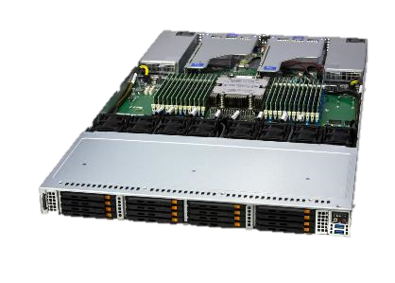
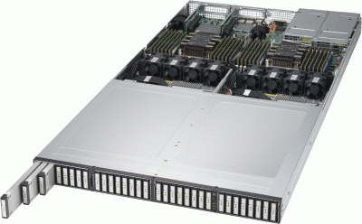
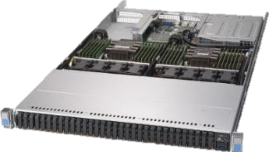
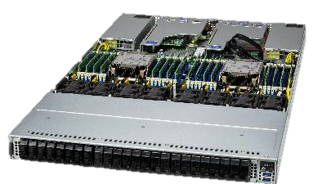
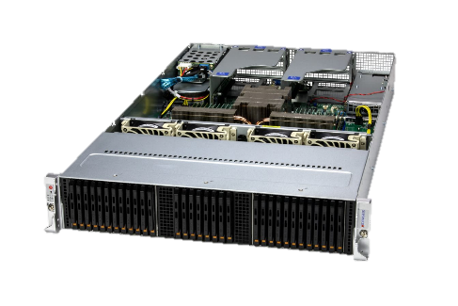
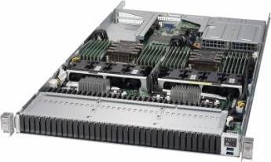
SMC EDSFF Storage Platform Release Timeline
Industry Leader for the EDSFF All-NVMe SSD Platforms
PCIe Gen3 E1.L
PCIe Gen3 E1.S & NF1
PCIe Gen5 E1.S
PCIe Gen5 E3.S (CXL)
Intel CLX DP, 165W TDP
24 DIMMs DDR4
2 PCIe x16 HHHL slots
Intel CLX DP, 205W TDP
24 DIMMs DDR4
2 PCIe x16 FHHL slots
1 PCIe x4 HHHL slots
Intel SPR DP, 280W TDP
32 DIMMs DDR5
2 PCIe x16 OCP 3.0 slots
2 PCIe x16 FHHL slots
Intel SPR DP, 350W TDP
32 DIMMs DDR5
AMD Genoa UP, 380W TDP
24 DIMMs DDR5
2 PCIe x16 OCP 3.0 slots
2 PCIe x16 FHHL slots
18’
19’
22’
23’

Slide 6
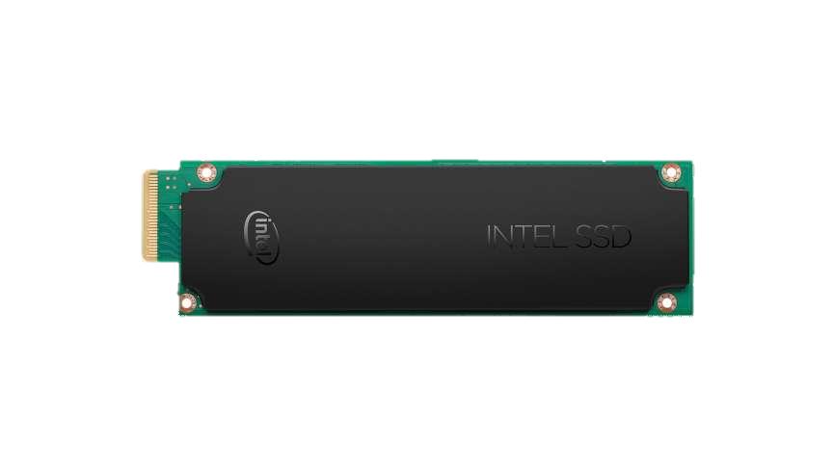
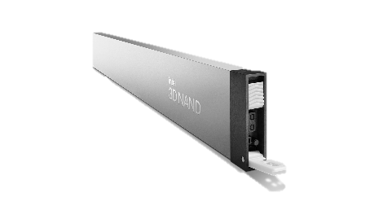
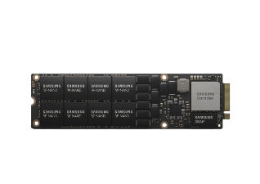
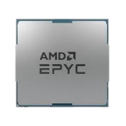
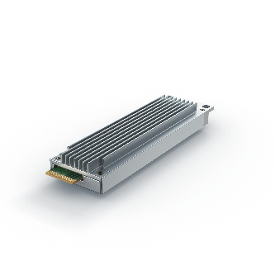
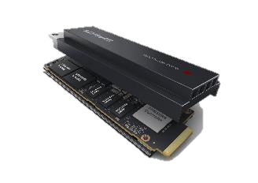
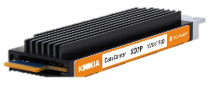
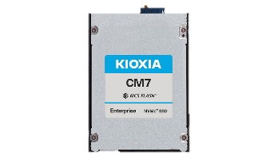
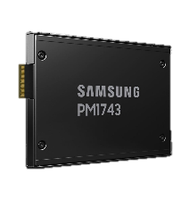
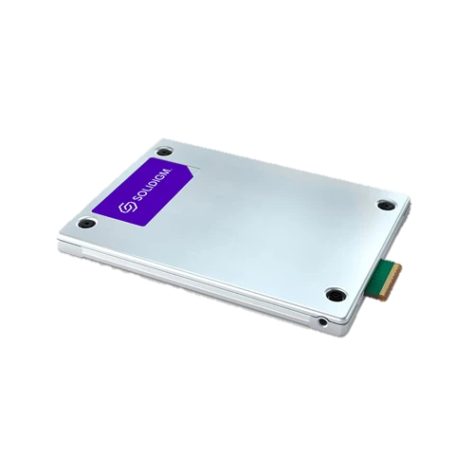
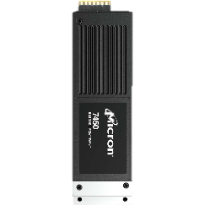
EDSFF Storage Platform Adoption
From Hyperscalers only to all Enterprise and Data Centers
Eco System Support
Hardware Readiness
PCIe Gen5 processor supports more PCIe lanes and higher cores
Data center networking infrastructure upgrade from 100Gb/s to 200Gb/s to 400Gb/s
2019
80 PCIe Lanes
64 cores
128 PCIe Lanes 128 cores
2023

Slide 7
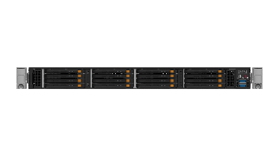
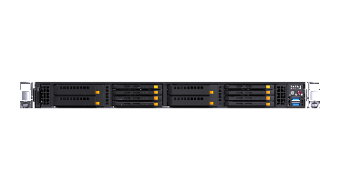
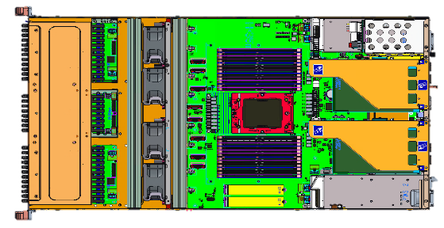
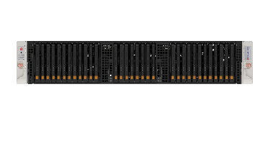
Gen5 Petascale EDSFF Platform Innovation
Purposed Built for New All-NVMe and Software-Defined Data Center
Unified Chassis
One chassis supports both Intel and AMD, 1U up-to 16 E3 SSD and 2U up-to 32 E3 SSD
Less than 32” depth
Balanced Architecture
Balanced PCIe lanes design for both storage IO and networking and eliminates the processor NUMA challenges
< 32” chassis depth
1U16, 2U32 and CXL
x48
x32
x64
x64
x48
x32
AMD Single Processor
Intel Dual Processor

Slide 8
Gen5 Petascale EDSFF Platform Innovation
Reduce Backplane Trace Layout Signal Loss & Improve Air Flow
Signal Integrity
Mainboard direct connection to SFF-TA-1002 1C connectors and reduce the SSD backplane routing signal loss
Reduce ~40% of the signal loss
Air Flow
No vertical SSD backplane blocking the air flow
~ 75% increase front opening
~ 20% improve system CFM
E3.S SSD + BPN
U.2 SSD + BPN
Notes:
MCIO to MCIO cables about 7db, BPN trace layout takes 4 to 5 db loss,

Slide 9
X13 Intel Based Petascale Flexible Topology
Total 160 PCIe 5.0 IO Lanes and Provide Balanced Front Storage and Rear IO Bandwidth in 1U Design
Ultra High Performance Storage
High Performance & Memory Hybrid Storage
High Performance and Density Storage
Ultra High Performance and Balanced Storage
PCIe
PCIe
PCIe
OCP
OCP
PCIe
OCP
OCP
PCIe
OCP
OCP
PCIe
OCP
OCP
OCP
OCP
OCP
OCP
x64
x64
x32
x64
SPR
UPI
SPR
SPR
UPI
SPR
SPR
UPI
SPR
SPR
UPI
SPR
x64
x64
x128
x96
AMD
CXL
1U 16x E3.S SSD (x4)
1U 8x E3.S SSD (x4) &
4x E3.S CXL (x8)
2U 32x E3.S SSD (x4)
2U 24x E3.S SSD (x4)
Subject to change without notice

Slide 10
H13 AMD Based Petascale Flexible Topology
The 128 PCIe 5.0 IO Lanes and Provide Balance Front Storage and Rear IO Bandwidth in both 1U and 2U Design
Ultra High Performance Storage
High Performance & Memory Hybrid Storage
High Performance and Density Storage
Petabyte Scale Massive Storage
PCIe
OCP
OCP
PCIe
PCIe
OCP
OCP
PCIe
OCP
OCP
PCIe
OCP
OCP
PCIe
x64
x64
x32
x64
AMD
AMD
AMD
AMD
x64
x64
x96
x64
CXL
1U 16x E3.S SSD (x4)
1U 8x E3.S SSD (x4) &
4x E3.S CXL (x8)
2U 24x E3.S SSD (x4)
2U 32x E3.S SSD (x2)
Subject to change without notice

Slide 11
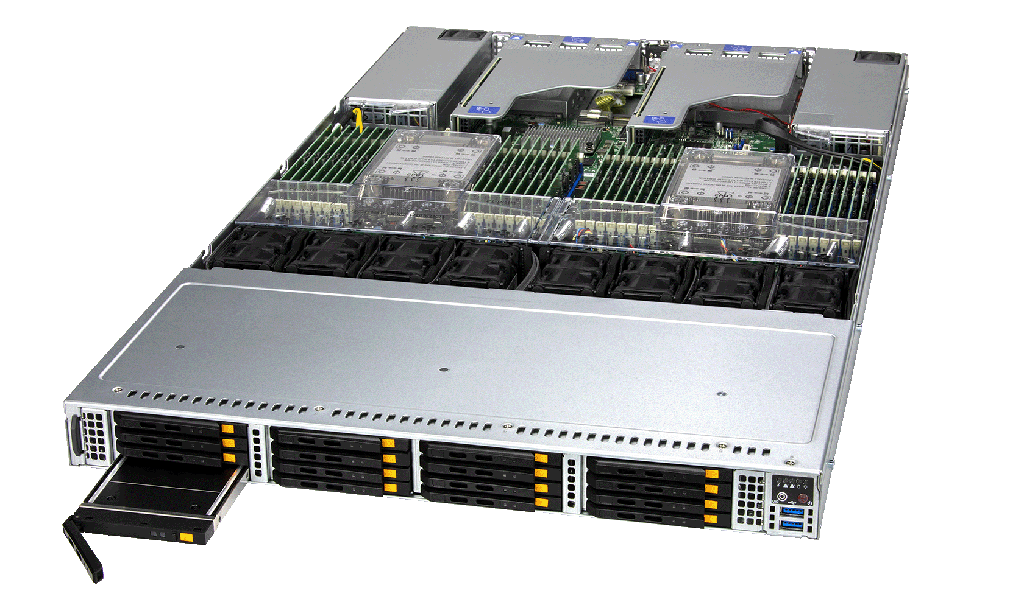
PCIe 5.0 Slots 2 x16 slots & 2x AIOMs
DDR5 Slots Up to 32 DIMMs
Dual Processor Up to 270W TDP
X13 1U Petascale All-Flash
E1.S/E3.S EDSFF Next-gen form factor
Redundant Power Supply 1600W (Titanium level)
Optional E3.S 2T x8 CXL Support
PCIe 5.0 Slots x16 AIOMs
PCIe 5.0 Slots x16 slots

Slide 12
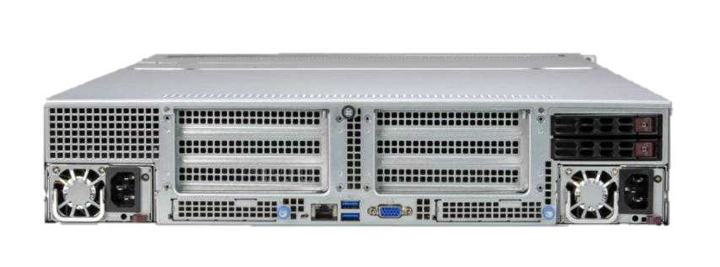
PCIe 5.0 Slots 2 x16 slots & 2 AIOMs
DDR5 Slots Up to 24 DIMMs
Dual Processor Up to 350W TDP
H13 2U Petascale All-Flash
E3.S EDSFF Up to 32 E3 1T slots
Redundant Power Supply 1600W (Titanium level)
Hot swap U.2
PCIe 5.0 Slots x16 AIOMs
PCIe 5.0 Slots x8 or x16 slots

Slide 13
Petascale All-NVMe Storage Key Advantages
Extreme Performance and Capacity to Support Software-Defined Data Center Workloads
230+
GB/s
128KB Sequential Read
New EDSFF connectors and system level design thermal optimization
Performance
Consolidate
30M+
IOSP
Cooling
Efficiency
4KB Random Read
- TLC, QLC and CXL support
- High performance database
- Hyperconverged infrastructure
- AI/MLOps storage
- Virtualization & dense VDI
- High performance Obj storage
1PB
All-NVMe storage in 2U
*w/ 30TB SSD
Capacity
Consolidate
Applications
flexible

Slide 14
CXL Memory Module Solutions through Side Band
Not As Simple as Just Cooling the CXL Memory Module
Compare to NVMe SSD Side Band Capability Versus CXL Devices
NVMe SSD
CXL Devices
Management Applications
Management Applications
Management Controller
Management Controller
NVMe Management Interface
NVMe Management Interface (Like)
Management Component Transport Protocol (MCTP)
CCI over Management Component Transport Protocol (MCTP)
MCTP over SMBus/I2C
MCTP over PCIe
MCTP over SMBus/I2C/I3C
MCTP over PCIe
SMBus/I2C
PCIe VDM
SMBus/I2C/I3C
PCIe VDM

Slide 15
CXL Memory Module Solutions through Side Band
Not As Simple as Just Cooling the CXL Memory Module
Compare to NVMe SSD Side Band Standard / Common Address Versus CXL Devices
NVMe SSD
CXL Devices
Common Address on VPD
No Unify Address on VPD/SPD
Common Address on SMBus
No Unify Address on SMBus
Common Address on NVMe MI
No Unify Address on NVMe MI Like Cmd
Common Address on Temperature Reporting
No Unify Address on Temperature Reporting

Slide 16
CXL Memory Module Solutions through Side Band
.
Type 1: Networking / Caching / Accelerator Devices
Type 2: Accelerator w/ Memory
Type 3: Memory
Network NIC, Smart NIC
GPU
Memory Capacity Expansion
CXL Device Type
xPU
Memory Bandwidth Expansion
Storage Class Memory
Protocols
Protocols
Protocols
CXL Device Protocol
CXL.io
CXL.cache
CXL.io
CXL.mem
CXL.cache
CXL.io
CXL.mem
Protocol Side Band Management
Protocol Side Band Management
Protocol Side Band Management
Existing Side Band Protocol
NC-SI + PLDM over MCTP
SMBus + SMB w/ PBI
CCI Type 3 + NVMe-MI Like Cmd Set
Coherent (PCIe) Interface and Protocol (CXL) but Still No Unified Device Attributes through Side Band Management Across All Device Types

Slide 17
Call to Action
Collaborate and build EDSFF eco system
E1.S and E3.S SSD
E3.S 2T CXL
Promote the EDSSF based enterprise and data center solutions

Slide 19
Thank You

